Slide 1

356815008
344663000
52040792
312511520
361059264
359477000
377606032
373748880
Telco Global API Alliance – CAMARA
Pathways towards a clear, consistent and transparent process for API onboarding and handling
27.07.2022

Slide 2
CAMARA governance structure
Steering Committee
Responsible for all aspects of oversight
Ways of working definition, creating/removing new/existing WGs, re-prioritization, etc.
Implementation guidelines
Priorities and roadmap
Commonalities WG
API backlog WG
QoD API
Feedback
Edge Cloud API
Feedback
….
”X” API
Governing body
API families
Transversal technical WGs
API WGs (Sub Projects)

Slide 3
Motivation
Problem statement
Decision on creating new Sub Projects to work out specific APIs has not been a major issue up to now.
Every API was more than welcome and new Sub Project was defined accordingly
The reason is that the number of APIs and contributions in CAMARA have been rather limited so far.
However, as CAMARA gains traction and more partners are bringing API proposals into the backlog, the as-is approach is no longer viable – it does not scale.
Additionally, external fora are asking us about the formal procedure to start working on a new API in CAMARA
Call for action
Agree on (and document) a clear, consistent transparent process for API onboarding and handling, that allows tracking the situation of APIs from their introduction in the backlog to their final incorporation to the CAMARA portfolio as technically/commercially available.
Note
The intention is not making the process more complicated or slow it down, but add certainty and transparency, and hopefully speed it up and gain scale (grow quickly the API portfolio) by growing confidence in the participants.

Slide 4
Proposal
https://github.com/camaraproject/WorkingGroups/issues
Commonalities
Github issue #53
Clear, consistent and transparent process for API onboarding and handling
API backlog
Anchor point – Problem statement, call for action and working topics structure
legend
Github issue #57
API proposal pipeline: from API backlog to SteerCo approval
Github issue #12
Change for APIBacklog
Github issue #59
Complete release of an API - checklist
Specify the steps that compose the pipeline.
Elaborate on a template with all the information that a partner should fill out when proposing a new API (family) to CAMARA.
Summary report to be sent to the SteerCo
Work out guidelines for the SteerCo to decide on new Sub Projects.
Consolidate one single table for the API backlog. This backlog shall capture info on APIs that have been already proposed for adoption, and APIs suggested from other sources (OPAG)
Develop a checklist for an "API is ready to use". Which deliverables are necessary for a complete release of an API?

Slide 5
Proposal
https://github.com/camaraproject/WorkingGroups/issues
Commonalities
Github issue #53
Clear, consistent and transparent process for API onboarding and handling
API backlog
Anchor point – Problem statement, call for action and working topics structure
legend
Github issue #57
API proposal pipeline: from API backlog to SteerCo approval
Github issue #12
Change for APIBacklog
Github issue #59
Complete release of an API - checklist
Specify the steps that compose the pipeline.
Elaborate on a template with all the information that a partner should fill out when proposing a new API (family) to CAMARA.
Summary report to be sent to the SteerCo
Work out guidelines for the SteerCo to decide on new Sub Projects.
Consolidate one single table for the API backlog. This backlog shall capture info on APIs that have been already proposed for adoption, and APIs suggested from other sources (OPAG)
Develop a checklist for an "API is ready to use". Which deliverables are necessary for a complete release of an API?

Slide 6
Issue #57 (1/4) Specify the steps that compose the pipeline
As-is (old) workflow
WG (Where?)
API backlog WG
SteerCo
API Sub Project
Do participants see value in the API?
Action (What?)
Provide high-level info on API…
usability (scenarios)
Input params
Output params
Providing comments, asking for clarification or suggesting enhancements
Fill out user story template agreed in Commonalities
Green light to start working on the actual API, and allocates it into a new/existing API Sub Project
API lifecycle mgmt (developm., validation, maintenance,…)
YES
NO
Owner (Who?)
Company ”X”
WG participants
Company ”X”
Head of delegation
Company “X”, all
No go!
Tentative (new) workflow
API backlog WG
SteerCo
API Sub Project
Is the template duly filled out?
Submit API proposal, by filling out a well-defined template (see slide 7)
YES
Each company declares their support/no support to the API proposal
Send the API proposal to SteerCo for approval, with a summary report (see slide 8)
Ack’es net neutrality impact assessment.
Decide on the allocation of the API proposal into an existing/new API Sub Project, based on well-defined decision criteria (slide 9)
API lifecycle mgmt (developm., validation, maintenance,…)
NO
Company ”X”
WG participants
WG coordinator
Head of delegation
Company “X”, all
Time window 1
Time window 2

Slide 7
Issue #57 (2/4) Elaborate on a template with all the information that a partner should fill out when proposing a new API (family) to CAMARA.
Summary
This template will be used as checklist to decide on including/not including the API proposal in the backlog.
Upload this template into “API backlog /TBD” directory, with this filename: APIproposal_<name>_<owner>.md
Fields | Description
API proposal name | API proposal name
API proposal owner | Company “X”
API summary | High level description of API objective, and 2/3 examples of in-scope business cases
Technical viability | Identify the underlying network/cloud capabilities which are needed for the support of CAMARA API, relating these capabilities them to standards maturity. Example: this API requires the availability of NEF with this Rel-15 “X” feature.
Commercial viability | Specify the availability of commercial (or industrialized open-source) solutions for the identified network/cloud capabilities.
User story | Fill out the user story template agreed in Commonalities with API details
Net Neutrality impact | The company presenting an API make an initial assement. The GSMA (public policy experts with support from Policy Group) could help the CAMARA SteerCo in making a final assessment before taking the API for approval
YAML code available? | YES / NO.
Validated in lab/production env? | YES / NO. If YES, specify if it was lab network or production network.
Validated with real customers? | YES / NO. If YES, specify how many customers participated in the evaluation , and their use cases.
Validated with operators? | YES / NO. If YES, specify which operators participated in the evaluation.

Slide 8
Issue #57 (3/4) Summary report to be sent to the SteerCo
After Time Window 2, the API backlog coordinator sends a summary report for SteerCo approval. An example of summary report structure.
Fields | Description
API proposal name | API proposal name
API proposal owner | Company “X”
API proposal registration date | YYYY/MM/DD
API proposal supporters | Specify the companies that support the API proposal
Checklist (YES/NO) | Technically viable? | Commercially viable? | YAML code available? | Validated in lab/prod env? | Validated with customers? | Validated with operators?
Net neurality impact | The GSMA (public policy experts with support from Policy Group) will use this info to help CAMARA SteerCo in making a final assessment before taking the API for approval.

Slide 9
Issue #57 (4/4) Work out guidelines for the SteerCo to decide on new Sub Projects.
Upon receiving the summary report from the API backlog coordinator, SteerCo triggers a two-step procedure.
Step #1: SteerCo contacts GSMA (Public Policy Expert with support from Policy Group) to help making a final assessment on API adherence to Net Neutrality.
During the meeting in Kuala Lumpur there was a comment around the impact of the APIs on Net Neutrality -> worthwhile taking precautionary measures around it, ensuring net neutrality is considered by design in the API, from day 1.
This step will not necessarily slow down the process, but will help much in defending our message in front of Regulators and Public Adminisrations in the future.
Step #2: SteerCo decides on the allocation of API proposal into an existing/new Sub Project.
Main tenets for SteerCo decision
Open-source projects are contribution-driven. There should no be guidelines to prevent partners to contribute.
If a partner/customer/OPAG would like to contribute a certain API (which is on priority ”X” in the backlog, not necessarily priority 1) he is welcome to do it.
SteerCo shall make sure that APIs belonging together (close topic/content, API families) are developed within the same Sub Project, while ensuring that Sub Projects are not too small (i.e., difficult to track them down) or too big (difficult to be managed).
There could be situations where API proposal complies with acceptance criteria (template duly filled out, adherence to net neutraility), but has not supporters other than the proponent company. What to do in this situation?
Recommendation is to accept the API proposal, and sees how successful will be in terms of industry adoption.

Slide 10
Proposal
https://github.com/camaraproject/WorkingGroups/issues
Commonalities
Github issue #53
Clear, consistent and transparent process for API onboarding and handling
API backlog
Anchor point – Problem statement, call for action and working topics structure
legend
Github issue #57
API proposal pipeline: from API backlog to SteerCo approval
Github issue #12
Change for APIBacklog
Github issue #59
Complete release of an API - checklist
Specify the steps that compose the pipeline.
Elaborate on a template with all the information that a partner should fill out when proposing a new API (family) to CAMARA.
Summary report to be sent to the SteerCo
Work out guidelines for the SteerCo to decide on new Sub Projects.
Consolidate one single table for the API backlog. This backlog shall capture info on APIs that have been already proposed for adoption, and APIs suggested from other sources (OPAG)
Develop a checklist for an "API is ready to use". Which deliverables are necessary for a complete release of an API?

Slide 11
Issue #12 (1/2) Change for API backlog
As-is approach
We keep different API backlogs, with no apparent relationship across them.
Original CAMARA backlog (2021Q4), with some proposals for refinement (2022Q1)
OPAG backlog (2022Q2), with a list of APIs sorted out in terms of priorities.
Actual CAMARA backlog, capturing the proposals received from companies since API backlog WG kick-off.
New approach
It is suggested to keep all the information in one single table.
Easy to be managed
One single entry point for external community.
This table is to be called “API backlog.md”, and it is to be allocated to “APIBacklog/TBD” directory.

Slide 12
Issue #12 (2/2) Change for API backlog
Once a partner/customer/OPAG submits the API proposal with the filled-in template in slide 7, a new entry is added to “API backlog.md”.
API backlog.md file structure.
API proposal name | API proposal owner | Market value (customer priority) & technical feasibility | API proposal registration date | Status | API proposal supporters | Link to the filled-in template
Name 1 | Company “X” | NOTE 1 | YYYY/MM/DD | NOTE 2 | Company “A”, “B” | NOTE 3
Name 2 | Company “A” | NOTE 1 | YYYY/MM/DD | NOTE 2 | Company “C” | NOTE 3
… | …. | …. | …. | ….. | ….
Name N | OPAG | NOTE 1 | YYYY/MM/DD | NOTE 2 | Company “A”, “B”,… | NOTE 3
NOTE 1: We need to agree on how this priority should be captured, either with numbers (what is the scale) or with other tags (short-term, medium-term, long-term). Who is supposed to fill out the priority? Should be the API backlow WG or the SteerCo? NOTE 2: Submitted (before time window 1); under evaluation (time window 1); seeking for supporters (time window 2); ready for SteerCo approval (after time window 2); NOTE 3: URL where the filled-in template (slide 7) for API proposal has been submitted. If no URL is specified, it is assumed that no submission has been done yet; in such a case, the API is captured in the backlog for guidance/reference for future submissions.

Slide 13
Proposal
https://github.com/camaraproject/WorkingGroups/issues
Commonalities
Github issue #53
Clear, consistent and transparent process for API onboarding and handling
API backlog
Anchor point – Problem statement, call for action and working topics structure
legend
Github issue #57
API proposal pipeline: from API backlog to SteerCo approval
Github issue #12
Change for APIBacklog
Github issue #59
Complete release of an API - checklist
Specify the steps that compose the pipeline.
Elaborate on a template with all the information that a partner should fill out when proposing a new API (family) to CAMARA.
Summary report to be sent to the SteerCo
Work out guidelines for the SteerCo to decide on new Sub Projects.
Consolidate one single table for the API backlog. This backlog shall capture info on APIs that have been already proposed for adoption, and APIs suggested from other sources (OPAG)
Develop a checklist for an "API is ready to use". Which deliverables are necessary for a complete release of an API?

Slide 14
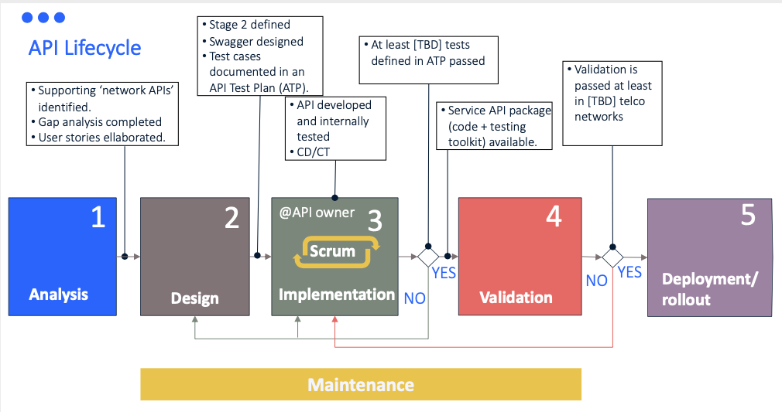
Issue #59 Complete release of an API - checklist
Implementation -> validation
YAML code available.
YAML code compliant with documented API design guidelines: structure (headers/notifications,..) and AuthN / Z
API Test Plan (ATP) documentation available: list of test cases.
API documentation available, with information on release/versioning.
Release cycle: {4-6} months. Each API release incorporates add-ons or fix bugs.
Validation -> deployment/rollout
Tested by at least 2 operators.
Service API package available, containing:
YAML code
API documentation
Testing campaign documentation, with test cases validated and results.

Slide 15

Q&A

